Slide 1
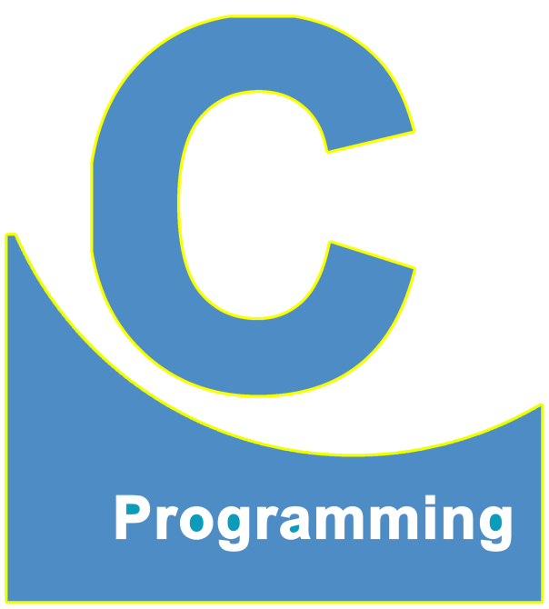
01
02
C Language
Lecture 21
04

Slide 2


Today’s Agenda
01
The “switch” statements
02
Some Example

Slide 3
The "switch" Statement
another way of writing conditional statements
syntax:
switch(var_name)
{
case value 1:
....
....
case value 2:
....
....
case value 3:
....
....
.
.
default:
....
....
}

Slide 4
Exercise
Write a program to accept weekday from the user and print the name of the corresponding day the
entered weekday
EX:
i.) Enter Number of Weekday:1
Monday
ii.) Enter Number of Weekday:8
Wrong Input! Try Again.

Slide 5
Solution
void main()
{
int no;
clrscr();
printf("Enter Number of Weekday:");
scanf("%d", &no);
if(no == 1)
printf("Monday");
else if(no == 2)
printf("Tuesday");
else if(no == 3)
printf("Wednesday");
else if(no == 4)
printf("Thursday");
else if(no == 5)
printf("Friday");
else if(no == 6)
printf("Saturday");
else if(no == 7)
printf("Sunday");
else
printf("Wrong Input! Try Again.");
getch();
}

Slide 6
Exercise
Above Code Using "switch" statement

Slide 7
Solution
void main()
{
int no;
clrscr();
printf("Enter Number of Weekday:");
scanf("%d", &no);
switch(no)
{
case 1:
printf("Monday");
case 2:
printf("Tuesday");
case 3:
printf("Wednesday");
case 4:
printf("Thursday");
case 5:
printf("Friday");
case 6:
printf("Saturday");
case 7:
printf("Sunday");
default:
printf("Wrong Input! Try Again.");
}
getch();
}

Slide 8
Exercise
improved version of the above code

Slide 9
Solution
void main()
{
int no;
clrscr();
printf("Enter Number of Weekday:");
scanf("%d", &no);
switch(no)
{
case 1:
printf("Monday");
break;
case 2:
printf("Tuesday");
break;
case 3:
printf("Wednesday");
break;
case 4:
printf("Thursday");
break;
case 5:
printf("Friday");
break;
case 6:
printf("Saturday");
break;
case 7:
printf("Sunday");
break;
default:
printf("Wrong Input! Try Again.");
}
getch();
}

Slide 10
Improved syntax of the switch statement
switch(var_name)
{
case value 1:
....
....
break;
case value 2:
....
....
break;
case value 3:
....
....
break;
.
.
default:
....
....
}

Slide 11
Exercise
Write a program to accept two integers from the user and then ask the user to select an operation to be performed on those numbers. The operations to be performed are:
Addition
Subtraction
Multiplication
Division
Finally, perform the operation as selected by the user.
EX:
Enter 2 integers:10 20
Select an operation:
1. Addition
2. Subtraction
3. Multiplication
4. Division
Enter your choice: 3
Multiplication is 200

Slide 12
Solution
void main()
{
int a, b, choice;
clrscr();
printf("Enter 2 integers:");
scanf("%d %d", &a, &b);
printf("Select an operation:\n");
printf("1. Addition\n2. Subtraction\n3. Multiplication\n4. Division");
printf("\nEnter your choice:");
scanf("%d", &choice);
switch(choice)
{
case 1:
printf("Sum is %d", a + b);
break;
case 2:
printf("Difference is %d", a - b);
break;
case 3:
printf("Multiplication is %d", a * b);
break;
case 4:
printf("Division is %f", (float)a/b);
break;
default:
printf("Wrong Choice!");
}
getch();
}

Slide 13
Exercise
Write a program to accept two integers from the user and then ask the user to select an operation to be performed on those numbers. The operations to be performed are:
Addition
Subtraction
Multiplication
Division
Finally, perform the operation as selected by the user.
EX:
Enter 2 integers:10 20
Select an operation:
A. Addition
S. Subtraction
M. Multiplication
D. Division
Enter your choice: M
Multiplication is 200

Slide 14
Solution
void main()
{
int a, b;
char choice;
clrscr();
printf("Enter 2 integers:");
scanf("%d %d", &a, &b);
printf("Select an operation:\n");
printf("A. Addition\nS. Subtraction\nM. Multiplication\nD. Division");
printf("\nEnter your choice:");
fflush(stdin);
scanf("%c", &choice);
switch(choice)
{
case 'A':
printf("Sum is %d", a + b);
break;
case 'S':
printf("Difference is %d", a - b);
break;
case 'M':
printf("Multiplication is %d", a * b);
break;
case 'D':
printf("Division is %f", (float)a/b);
break;
default:
printf("Wrong Choice!");
}
getch();
}

Slide 15
Exercise
Write a program to accept two integers from the user and then ask the user to select an operation to be performed on those numbers. The operations to be performed are:
Addition
Subtraction
Multiplication
Division
Finally, perform the operation as selected by the user.
EX:
Enter 2 integers:10 20
Select an operation:
A/a. Addition
S/s. Subtraction
M/m. Multiplication
D/d. Division
Enter your choice: m
Multiplication is 200

Slide 16
Solution
void main()
{
int a, b;
char choice;
clrscr();
printf("Enter 2 integers:");
scanf("%d %d", &a, &b);
printf("Select an operation:\n");
printf("A/a. Addition\nS/s. Subtraction\nM/m. Multiplication\nD/d. Division");
printf("\nEnter your choice:");
fflush(stdin);
scanf("%c", &choice);
switch(choice)
{
case 'A':
printf("Sum is %d", a + b);
break;
case 'a':
printf("Sum is %d", a + b);
break;
case 'S':
printf("Difference is %d", a - b);
break;
case 's':
printf("Difference is %d", a - b);
break;
case 'M':
printf("Multiplication is %d", a * b);
break;
case 'm':
printf("Multiplication is %d", a * b);
break;
case 'D':
printf("Division is %f", (float)a/b);
break;
case 'd':
printf("Division is %f", (float)a/b);
break;
default:
printf("Wrong Choice!");
}
getch();
}

Slide 17
Exercise
Improved version of above code

Slide 18
Solution
void main()
{
int a, b;
char choice;
clrscr();
printf("Enter 2 integers:");
scanf("%d %d", &a, &b);
printf("Select an operation:\n");
printf("A/a. Addition\nS/s. Subtraction\nM/m. Multiplication\nD/d. Division");
printf("\nEnter your choice:");
fflush(stdin);
scanf("%c", &choice);
switch(choice)
{
case 'A':
case 'a':
printf("Sum is %d", a + b);
break;
case 'S':
case 's':
printf("Difference is %d", a - b);
break;
case 'M':
case 'm':
printf("Multiplication is %d", a * b);
break;
case 'D':
case 'd':
printf("Division is %f", (float)a/b);
break;
default:
printf("Wrong Choice!");
}
getch();
}

Slide 19
Exercise
above code can also be written as

Slide 20
Solution
void main()
{
int a, b;
char choice;
clrscr();
printf("Enter 2 integers:");
scanf("%d %d", &a, &b);
printf("Select an operation:\n");
printf("A/a. Addition\nS/s. Subtraction\nM/m. Multiplication\nD/d. Division");
printf("\nEnter your choice:");
fflush(stdin);
scanf("%c", &choice);
switch(choice)
{
case 'A':case 'a':
printf("Sum is %d", a + b);
break;
case 'S':case 's':
printf("Difference is %d", a - b);
break;
case 'M':case 'm':
printf("Multiplication is %d", a * b);
break;
case 'D':case 'd':
printf("Division is %f", (float)a/b);
break;
default:
printf("Wrong Choice!");
}
getch();
}

Slide 21
Restrictions on switch
1. Case values can never be double or float.
EX:
case 1:
case 'A':
case 1.0:

Slide 22
Restrictions on switch
2. Case values can be character constant or integer constant but they can never be a
string constant.
EX:
case 'A':
case "A":

Slide 23
Restrictions on switch
3. We cannot write/use variables as case values. These case values must compulsorily be
constants.
EX:
i.) case 1:
case 2:
ii.) int x = 1, y = 2;
case x:
....
case y:
....

Slide 24
Restrictions on switch
4. We can use expressions as case values but these values must be integer or
character constant and not float or double constant.
EX:
case 1 + 2: //expression----> 3
....
case 'A' + 'B': //expression----> 121
....
case 10.0 / 4.0: //expression----> 2.5
....

Slide 25
Restrictions on switch
5. Two cases cannot have the same case value. In other words, cases cannot be
repeated.
EX:
case 1:
....
case 2:
....
case 1:
....

Slide 26
Restrictions on switch
6. Case values can never variables as a part of any expression.
EX:
case 1 > 2: //condition---->false----> 0 ----> case 0:
....
case a > b:
....

Slide 27
Try to find out the answer to this question
Which amongst switch and if is better and WHY?

Slide 28
Which is Better?
Which amongst switch and if is better and
WHY?
To answer this question guess the output of
the following code

Slide 29
Solution
int choice;
choice = 100;
switch(choice)
{
case 1:
....
....
break;
case 2:
....
....
break;
case 3:
....
....
break;
.
.
case 100:
....
....
break;
default:
....
}

Slide 30
Try to find out the answer to this question
Write a program using a switch statement to
accept a character from the user and check whether it is a vowel or not?

Slide 31
Solution
void main()
{
char ch;
clrscr();
printf("Enter a character:");
scanf("%c", &ch);
switch(ch)
{
case 'A':case 'E':case 'I':case 'O':case 'U':
case 'a':case 'e':case 'i':case 'o':case 'u':
printf("It is a vowel");
break;
default:
printf("Not a vowel");
}
getch();
}

Slide 32
Try to find out the answer to this question
Write a program to ask the user to select a figure amongst CIRCLE, RECTANGLE, and TRIANGLE, Then accept the dimensions of the selected figure and finally calculate and print its area.

Slide 33
Solution
void main()
{
int choice, length, breadth, radius;
clrscr();
printf("Select a figure:\n");
printf("1. CIRCLE\n2. RECTANGLE\n3. Triangle");
printf("\nEnter your choice:");
scanf("%d", &choice);
switch(choice)
{
case 1:
printf("Enter radius:");
scanf("%d", &radius);
printf("Area:%f", 3.14*pow(radius, 2));
break;
case 2:
printf("Enter length and breadth:");
scanf("%d %d", &length, &breadth);
printf("Area:%d", length * breadth);
break;
case 3:
printf("Enter base and height:");
scanf("%d %d", &length, &breadth);
printf("Area:%f", 0.5 * (length * breadth));
break;
default:
printf("Wrong Input! Try Again.");
}
getch();
}

Slide 34
Try to find out the answer to this question
Write a program to accept a character from the user and check whether it is a vowel or a consonant or something else.

Slide 35
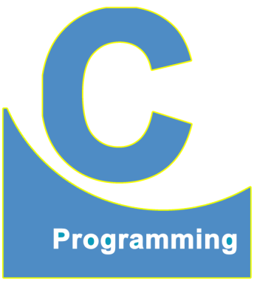
End of Lecture 21
For any queries mail us @: scalive4u@gmail.com
Call us @ : 0755-4271659, 7879165533
Thank you

